Slide 1

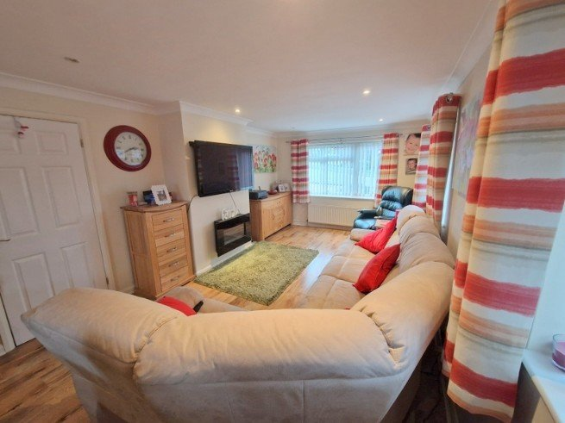
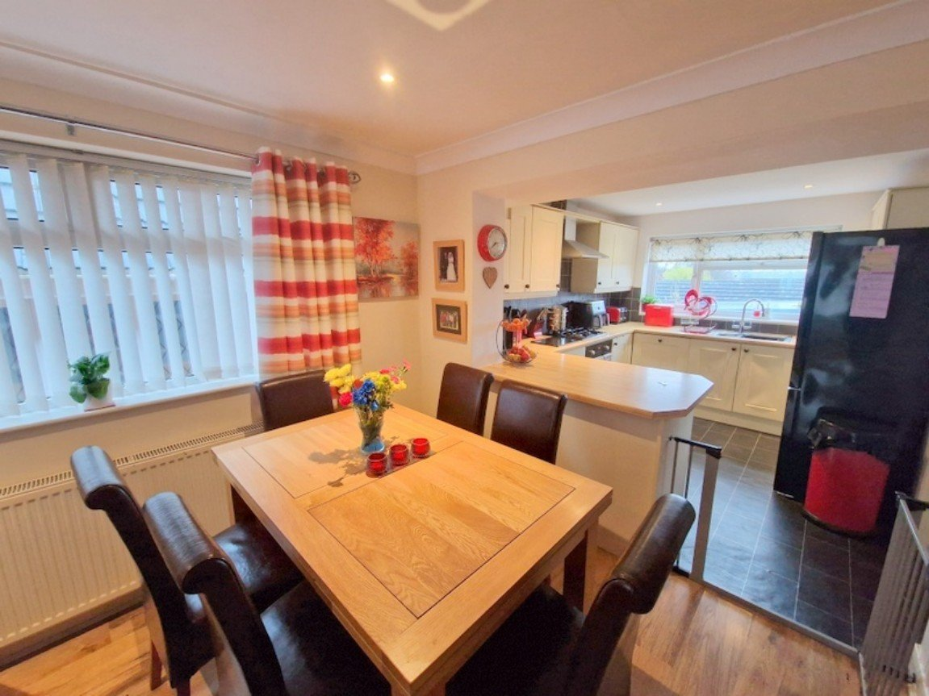

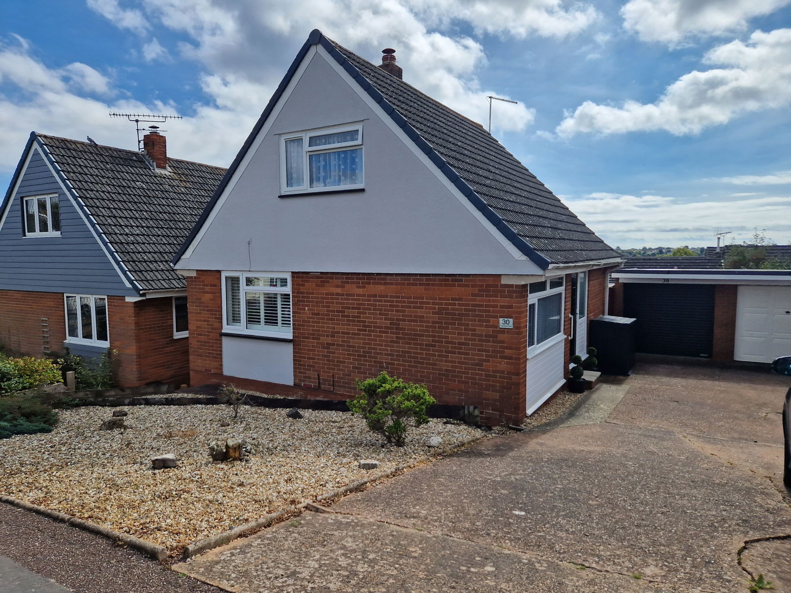
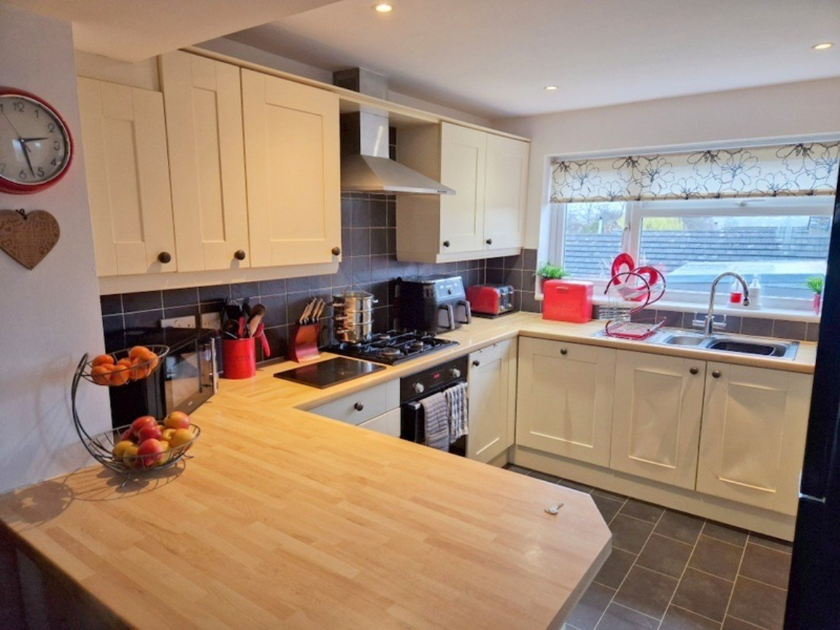
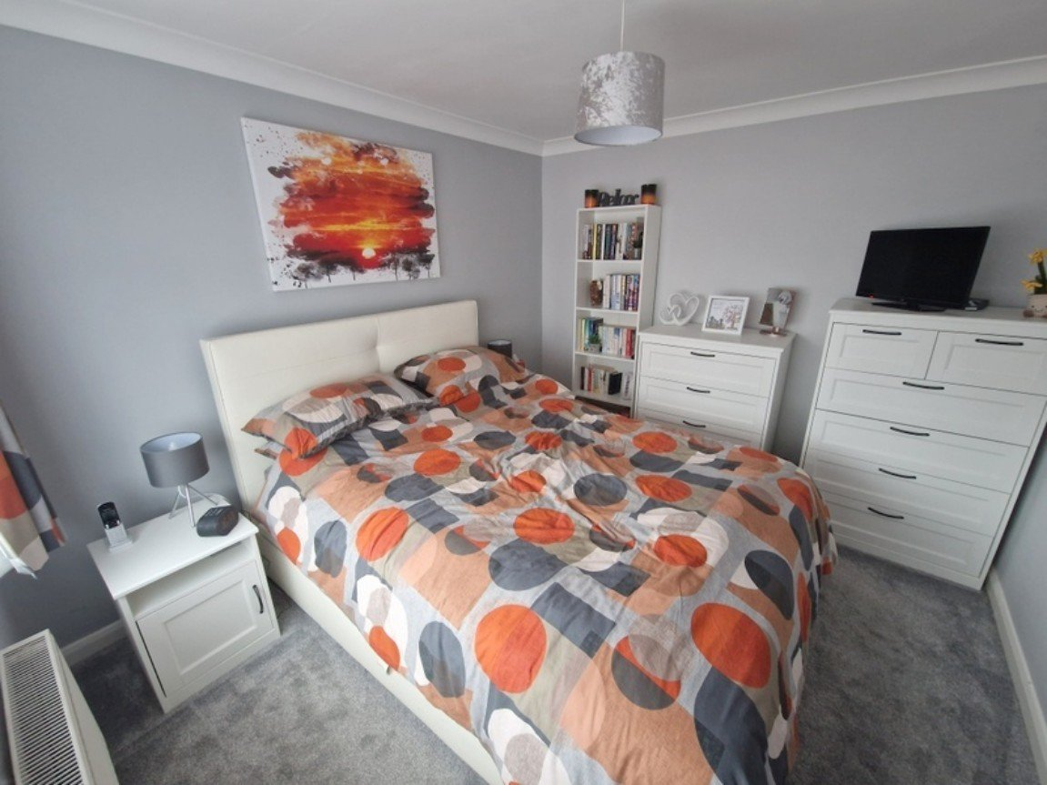
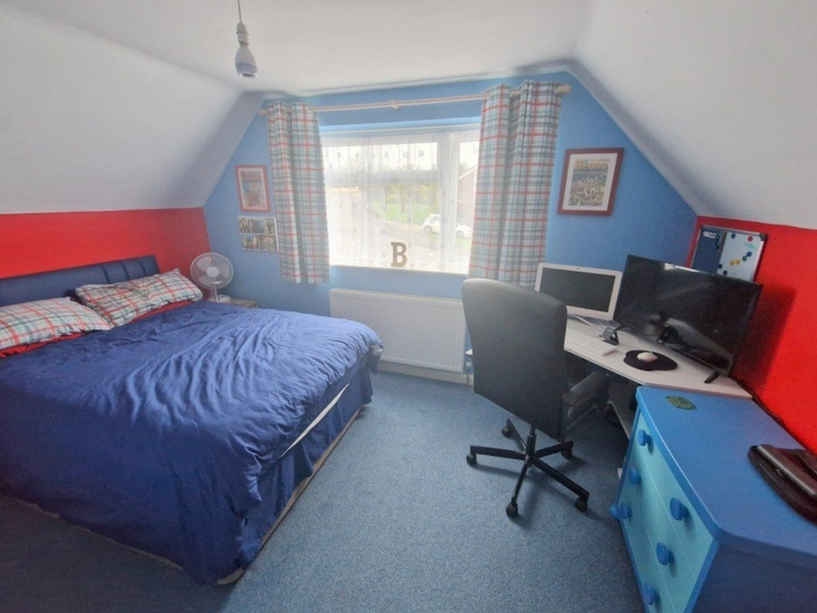
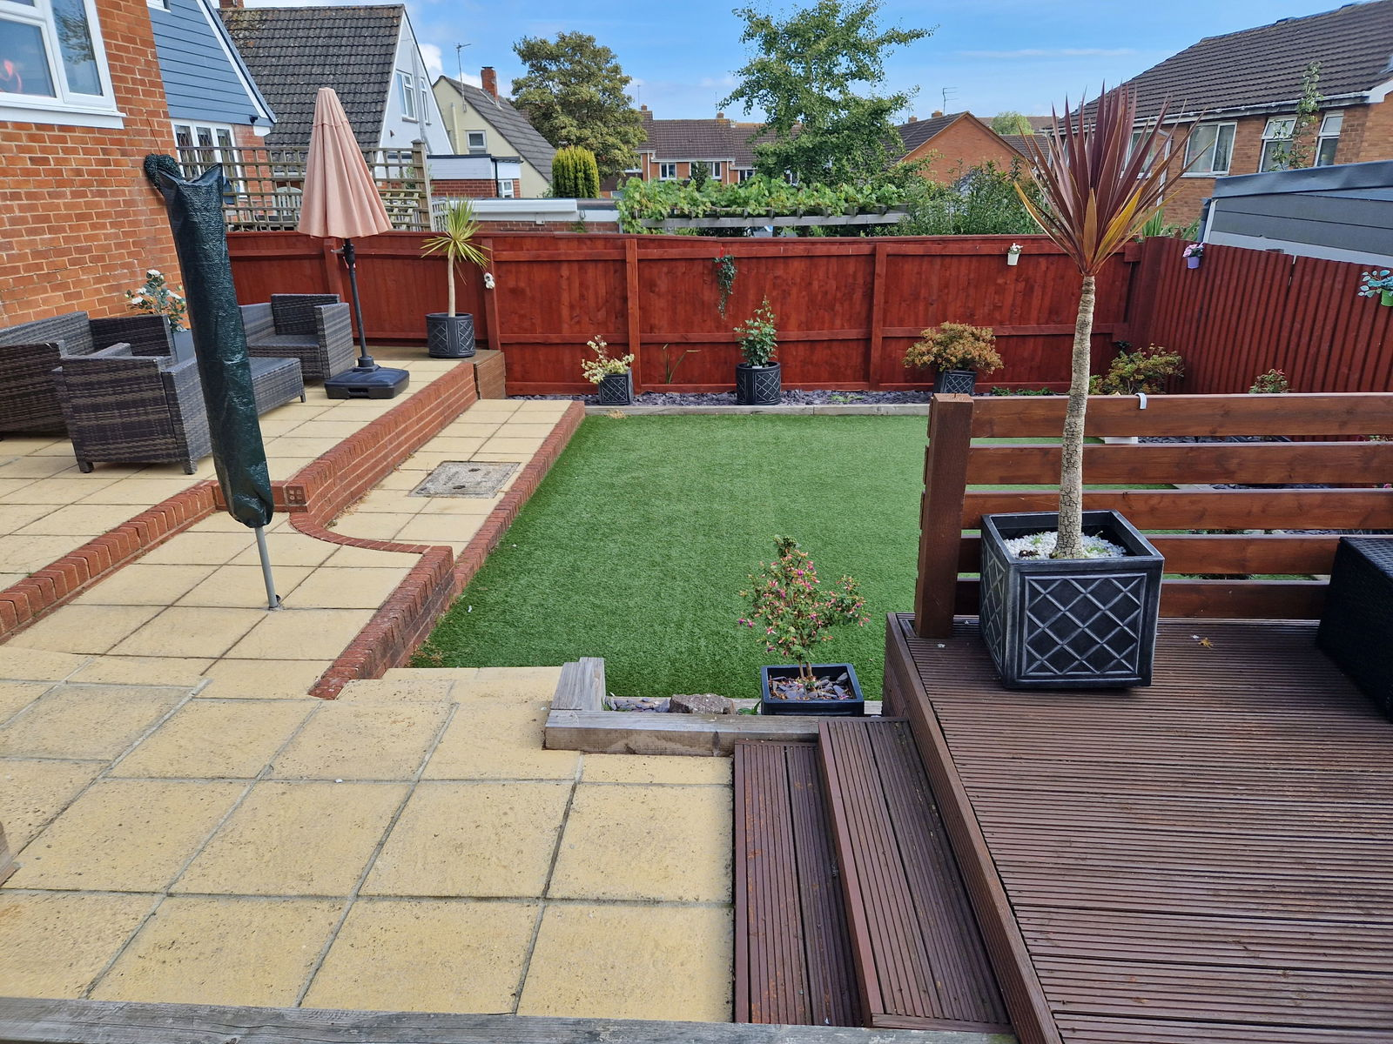
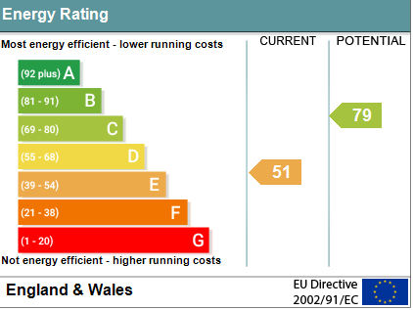


www.pennys.net
30, Greenpark Road, Exmouth, EX8 4JN
GUIDE PRICE £359,500
TENURE Freehold
A Very Well Presented Extended Detached Chalet Style Residence
Located In A Highly Popular And Convenient Area Close To Local
Shops And Schools
Excellent Extended Open Plan Kitchen/Dining/Living Room • Utility Room •
Ground Floor Bedroom One • Study/Walk-In Dressing Room •
Ground Floor Stylish Shower Room/WC • Two First Floor Bedrooms • First Floor Bathroom/WC • Gas Central Heating Via Modern Boiler • Double Glazed Windows •
Attractive Landscaped Front & Rear Gardens • Long Driveway And Garage •
Pennys Estate Agents Limited for themselves and for the vendor of this property whose agents they are give notice that:- (1) These particulars do not constitute any part of an offer or a contract. (2) All statements contained in these particulars are made without responsibility on the part of Pennys Estate Agents Limited. (3) None of the statements contained in these particulars are to be relied upon as a statement or representation of fact. (4) Any intending purchaser must satisfy himself/herself by inspection or otherwise as to the correctness of each of the statements contained in these particulars. (5) The vendor does not make or give and neither do Pennys Estate Agents Limited nor any person in their employment has any authority to make or give any representation or warranty whatever in relation to this property.
PENNYS ESTATE AGENTS
2 Rolle House, Rolle Street, Exmouth, Devon, EX8 2SN
Tel: 01395 264111 EMail: help@pennys.net

Slide 2
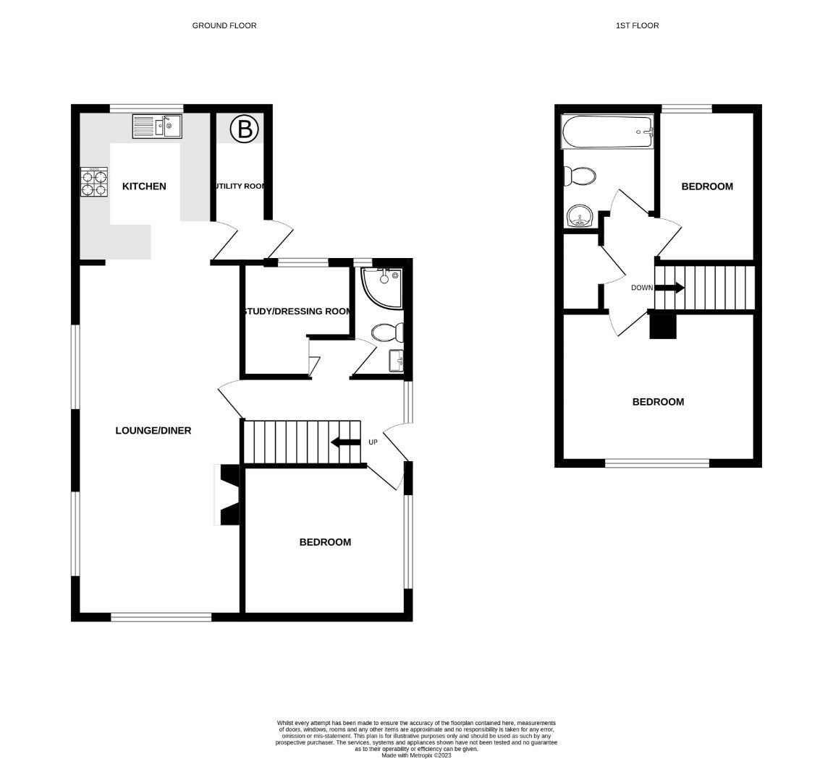
30, Greenpark Road, Exmouth, Devon, EX8 4JN
THE ACCOMMODATION COMPRISES:
Newly installed composite front door with patterned glass panel window inset and picture window side screen to one side giving access to the:
RECEPTION HALL:
With stairs rising to the first-floor landing with useful understairs recess and storage cupboard beneath; radiator housed in feature radiator cover; recess ceiling spotlighting; telephone point.
OPEN PLAN KITCHEN/DINING/LIVING ROOM:
A most spacious extended room with wood effect flooring throughout comprising of: LOUNGE/DINING ROOM: 8.23m x 3.35m (27'0" x 11'0") Three sets of double glazed windows overlooking the front and side aspects with window shutters; television point; wall mounted electric living flame effect fire; two radiators; coved ceiling; recess ceiling spotlighting; opening though to the KITCHEN: 3.12m x 2.72m (10'3" x 8'11") Fitted with a range of wood effect work top surfaces with tiled surrounds; inset one and a half bowl single drainer sink unit with hose style mixer tap; range of base cupboards, drawer units, integrated dishwasher beneath work tops; matching wall mounted cupboards; inset four ring gas hob with built-in oven below and stainless steel chimney style extractor hood over with light; space for upright fridge/freezer; recess ceiling spotlighting; uPVC double glazed window to rear aspect; door to:
UTILITY ROOM: 3m x 1.12m (9'10" x 3'8")
A very useful area with fitted work effect work top surfaces with space and plumbing for washing machine beneath; wall mounted modern Worcester gas boiler serving domestic hot water and central heating (still under guarantee); recess ceiling spotlighting; radiator; uPVC double glazed window with patterned glass; uPVC double glazed door with patterned glass giving access to outside.
GROUND FLOOR BEDROOM: 3.3m x 2.97m (10'10" x 9'9")
A good size double bedroom with uPVC double glazed window; radiator; coved ceiling; television point.
STUDY/DRESSING ROOM: 2.03m x 2.03m (6'8" x 6'8") maximum overall measurement.
uPVC double glazed window; range of wardrobes with sliding doors (these can be included within the sale if required).
GROUND FLOOR SHOWER ROOM/WC: 2.03m x 1.14m (6'8" x 3'9")
Stylishly fitted with a modern suite comprising of a shower cubicle with shower unit; wash hand basin with chrome mixer tap and cabinet beneath; WC with dual push button flush; splashback walls; chrome heated towel rail; recess ceiling spotlighting; uPVC double glazed window with patterned glass.
FIRST FLOOR LANDING:
Linen cupboard with slatted shelving.
BEDROOM TWO: 3.94m x 2.97m (12'11" x 9'9")
A good size double bedroom with uPVC double glazed window to front aspect; part sloping ceiling; radiator; access to eaves storage space; radiator; television point.
BEDROOM THREE: 3.02mx 2.18m (9'11" x 7'2")
uPVC double glazed window to rear aspect enjoying a pleasant open outlook; access to eaves storage space; radiator; part sloping ceiling; television point.
FIRST FLOOR BATHROOM/WC: 2.39m x 1.65m (7'10" x 5'5")
Comprising of a bath with shower unit over, splashback walls and shower splash screen; pedestal wash hand basin with tiled splashback; WC; chrome heated towel rail; recess ceiling spotlighting; skylight window; wood effect flooring; wall mounted mirror-fronted cabinet.
OUTSIDE:
There are attractively planned gardens to both the front and the rear of the property which are planned with ease of maintenance in mind. To the front there is a decorative stone garden area with shrubs; driveway providing ample off-road parking and leading to the GARAGE. A wooden side gate gives access through to the REAR GARDEN which is beautifully planned and landscaped comprising of an area laid to artificial lawn edged with slate stones; patio sun terrace and decked sun terrace both providing excellent spaces for al-fresco dining/entertaining. Outside cold water tap. Decked side pathway and gate gives access back round to the front of the front of the property.
GARAGE: 5.18m x 2.39m (17'0" x 7'10") approximately.
With electrically operated up and over door; power and light connected; double glazed window.
Agents Note; The windows, doors and wooden window shutters were installed in 2023 before the Energy Report was commissioned. The gas boiler has three years remaining of its warranty
MORTGAGE ASSISTANCE:
Mortgage Assistance: We are pleased to recommend Meredith Morgan Taylor, who would be pleased to help no matter which estate agent you finally buy through. For a free initial chat please contact us on to arrange an appointment. Your home may be repossessed if you do not keep up repayments on your mortgage. Meredith Morgan Taylor Ltd is an appointed representative of The Openwork Partnership, a trading style of Openwork Ltd which is authorised and regulated by the Financial Conduct Authority (FCA).
Floor Plan

